Slide 1
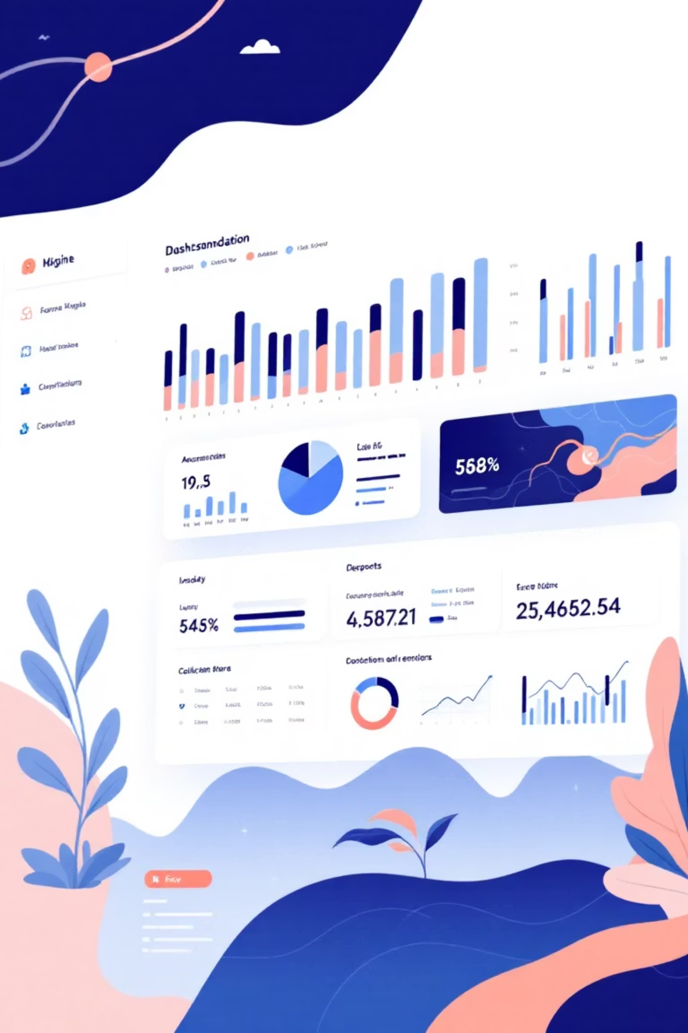
SaaS Funnel Analysis
Product Analytics Case Study
By: Pratim Rakshit | Data Source: Event-level logs (279 rows, PostgreSQL)

Slide 2


Objective
Drop-off Analysis
Identify where users exit the funnel
Stage Improvement
Pinpoint stages needing optimization
Tracking Validation
Ensure data consistency across events
Retention Insights
Analyze activation and repeat usage patterns

Slide 3





The User Journey
Visit
User lands on platform
Sign Up
Account creation
Onboard
Initial setup process
Activate
First value moment
Repeat Use
Return engagement

Slide 4
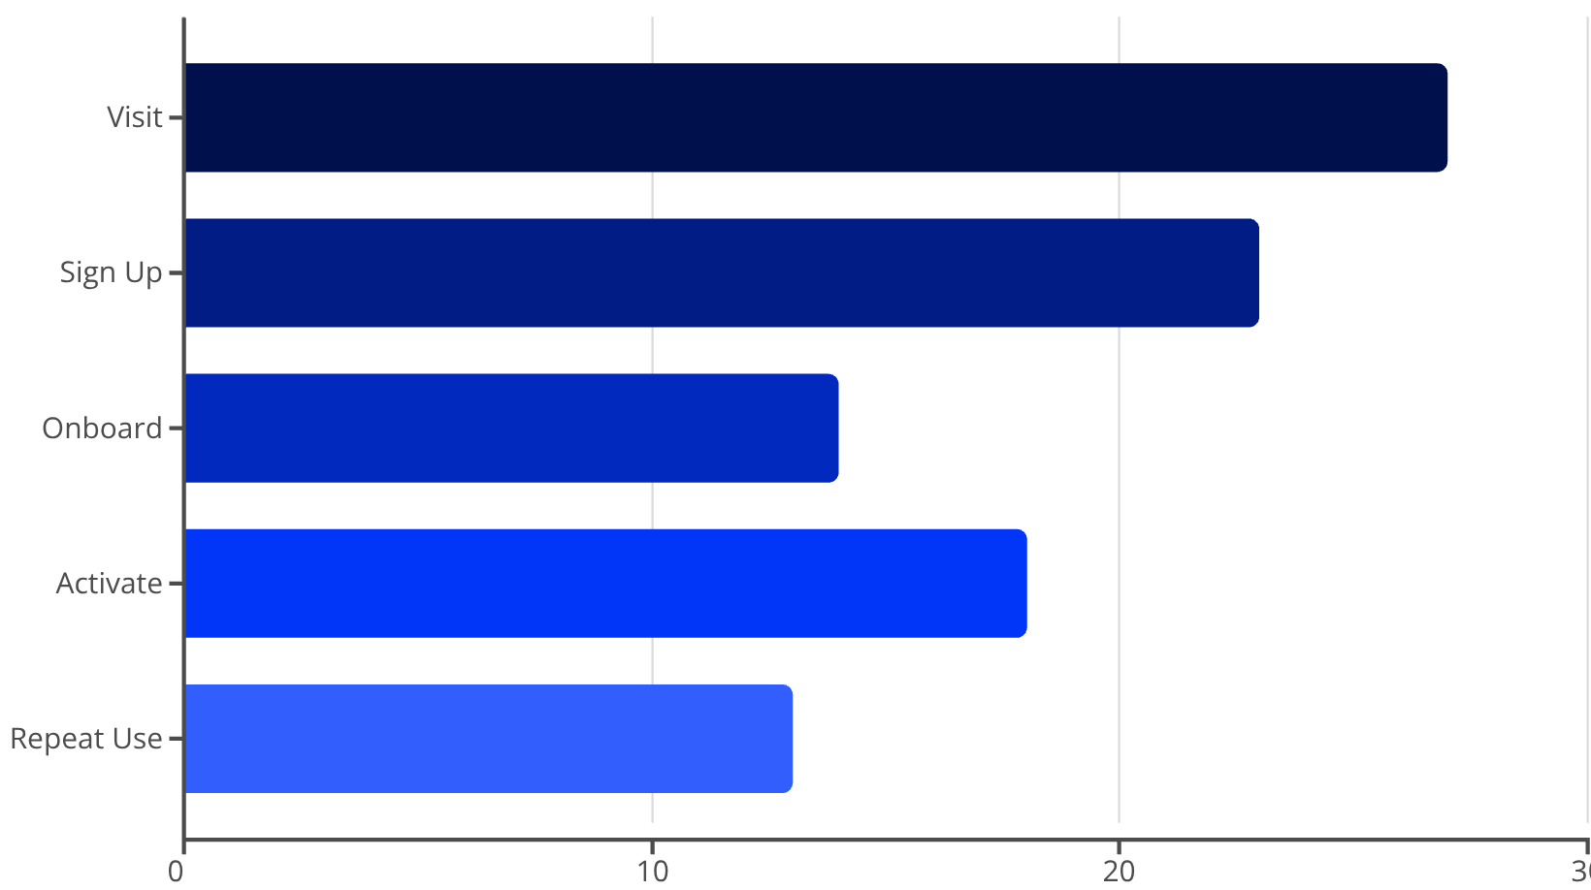
Funnel Performance Data
Stage Breakdown
The funnel shows strong initial engagement with 27 visits converting to 23 sign-ups. However, a significant drop occurs at onboarding (14 users), followed by an unusual increase at activation (18 users).
This pattern reveals both opportunities and data quality issues requiring immediate attention.

Slide 5
Conversion & Drop-off Metrics
Stage
Users
Conversion %
Drop-off %
Visit
27
85.2%
14.8%
Sign Up
23
60.9%
39.1%
Onboard
14
Tracking Issue
N/A
Activate
18
72.2%
27.8%
Repeat Use
13
—
—

Slide 6

85% Sign-Up Rate
Strong landing page performance indicates effective value proposition and frictionless sign-up flow. This is a positive signal for marketing and acquisition teams.

Slide 7
Critical Insights
Major Onboarding Drop-off
Tracking Error Detected
Strong Retention Signal
39% of signed-up users do NOT complete onboarding — the biggest leak in the funnel. Indicates onboarding friction, confusing UI, too many steps, or lack of user motivation.
Activation (18) > Onboarding (14) — impossible in a clean funnel. Proves missing onboarding events, incorrect event firing, or users activating without required onboarding.
72% of activated users return — the core product delivers value. Activation creates an "Aha!" moment, and retention is healthy once users activate.
This is the #1 area to improve.
This is an analytics instrumentation failure requiring event QA and tracking plan cleanup.

Slide 8


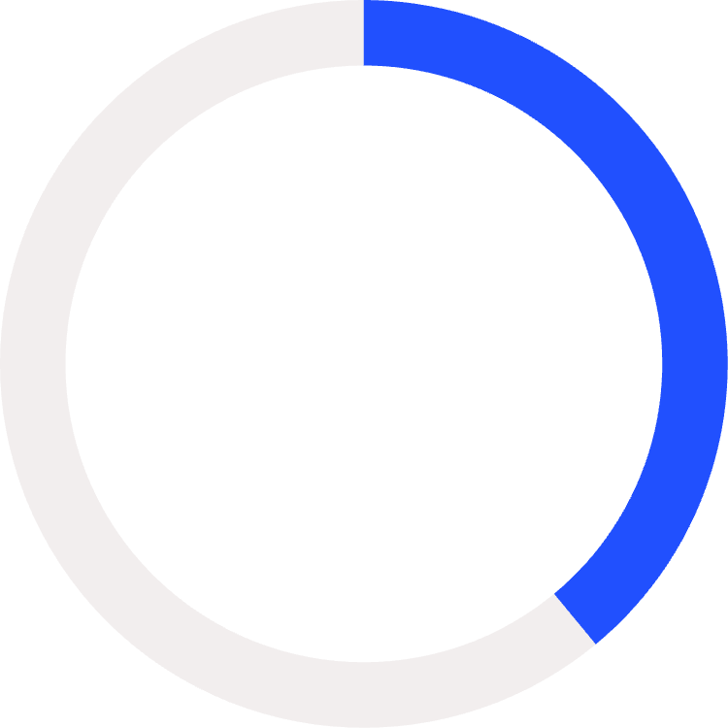
Key Findings Summary
85%
72%
39%
Acquisition
Activation
Onboarding Drop
Visit → Sign Up
Strong performance
Critical weakness
Strengths
Weaknesses
Acquisition performing well
Onboarding has major drop-off
Activation delivers value
Tracking broken between stages
Retention is healthy
Data integrity issues

Slide 9
Product Recommendations
01
02
Fix Onboarding Drop-Off
Fix Tracking Issues
Highest Priority: Reduce steps, remove unnecessary fields, add skip option, include progress bar, use tooltips, and provide templates.
Critical: Audit event instrumentation, ensure proper event ordering, validate frontend/backend tracking, use tracking plan, add QA.
Expected Impact: Higher completion, activation, and retention.
Expected Impact: Correct funnel data and reliable insights.
03
04
Strengthen Activation
Improve Early Retention
High ROI: Surface key features earlier, trigger "Aha!" moment faster, reduce friction, add focused tours, provide persona-based actions.
Use email reminders (Day 1, 3), in-app notifications, weekly summaries, highlight features, and auto-save sessions.
Expected Impact: Higher repeat use and long-term retention.
Expected Impact: Faster activation and higher retention.

Slide 10
Final Takeaways
Prioritize Onboarding
Restore Data Integrity
Fix the 39% drop-off with fewer steps, better guidance, and optional skips.
Resolve tracking inconsistencies to ensure reliable funnel analysis.
Leverage Activation
Nurture Users
Enhance the experience to capitalize on its strong retention correlation.
Use light nudges to strengthen early retention and encourage repeat usage.
Prepared by: Pratim Rakshit | Role: Product & Data Analyst | Tools: PostgreSQL, Excel, Power BI

